Slide 1
Water Level Indicator using 8051 Microcontroller

Slide 2
Contents
Introduction
Principle
Components required
Circuit Diagram
How to Operate
Algorithm & Code
Applications
Conclusion
References

Slide 3
Introduction
Water Level Indicator using 8051 Microcontroller project will help in automatically indicating the water level by sensing the water level in a tank.
Here, different water level of the tank(like low,half,full) is indicated on LCD (Liquid crystal Display). Using this system, we can avoid the overflow of the water.
In this system, water sensing can be done by using a set of 3 wires, which are placed at different levels in tank. DC supply probe is placed at the base of the tank.

Slide 4
Principle
This system mainly works on a principle that “water conducts electricity”.
Four wires which are dipped into the tank where three will indicate the different water levels and one for Vcc. Based on the outputs of these wires, microcontroller displays water level on LCD.
Initially when the tank is empty, LCD will display the message EMPTY. When some water added in tank then LCD display LOW and when water level reaches to half level, now LCD displays HALF.
When the tank is full, LCD displays FULL.

Slide 5
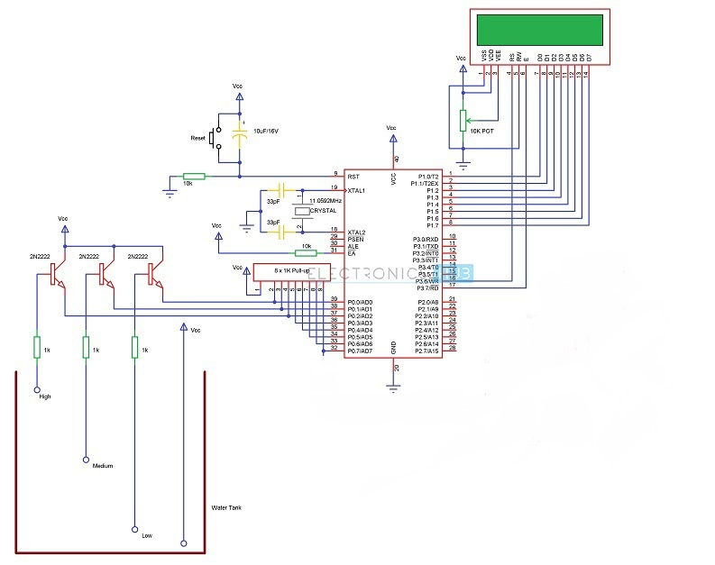
Circuit Diagram

Slide 6
Components Required
AT89S52 Microcontroller (or any 8051 based Microcontroller)
8051 Programmer (Programming Board)
11.0592 MHz Quartz Crystal
2 x 33pF Capacitor
2 x 10KΩ Resistor (1/4 Watt)
10µF Capacitor
Push Button
1KΩ x 8 Resistor Pack (for Pull – up)
16 x 2 LCD Display
3 x 2N2222 (NPN) Transistors
10KΩ Potentiometer
Programming cable
Connecting wires
Power Supply
MikroC PRO for 8051 IDE
Progisp Software (for burning code)

Slide 7
How to Operate Water Level Indicator Circuit using 8051 Microcontroller
Initially, write the program for Water Level Controller in MicroC Pro IDE and generate the .hex file.
Burn the program (.hex file) using progisp to the microcontroller using external programmer.
Now give the connections as per the circuit diagram.
Place the 4 water level indicating wires into the small tank (3 probes for three different levels and fourth one for common supply)
Switch on the supply.It will turn on even if the water level is EMPTY.
Now pour the water, when it reaches LOW level, then LCD displays LOW.
For middle level, it will display as HALF on the LCD.
Still if you pour the water, then the water level reaches full and the LCD displays FULL.
Switch off board supply.

Slide 8
Algorithm
First configure the controller pins P0.0, P0.1 and P0.2 as inputs and P2 as output.
Now, initialize the LCD.
Continuously check the water level input pins P0.0, P0.1 and P0.2.
If all the pins are low, then display tank as “EMPTY” on the LCD and make P0 pin HIGH.
If the level is low i.e. if P0.0 is HIGH, display the water level as LOW.
A HIGH pulse on the pin P0.1 indicates that water has reached half level. So, display the same thing on LCD.
If P0.2 is HIGH, then the water level in the tank is FULL.

Slide 9
C Code
// Lcd module connections
sbit LCD_RS at P2_0_bit; // RS pin connected to port P2^0
sbit LCD_EN at P2_1_bit;
// for output
sbit LCD_D4 at P2_2_bit;
sbit LCD_D5 at P2_3_bit;
sbit LCD_D6 at P2_4_bit;
sbit LCD_D7 at P2_5_bit;
//for inputs
sbit lower at P0_0_bit;
sbit middle at P0_1_bit;
sbit high at P0_2_bit;
char i;
void Move_Delay() { // Function used for text moving
Delay_ms(500); // You can change the moving speed here
}

Slide 10
void main(){
Lcd_Init(); // Initialize Lcd
lower = middle = high = 0;
while(1) {
while(lower == 0 && middle == 0 && high == 0){
Lcd_Cmd(_LCD_CLEAR); // Clear display
Lcd_Cmd(_LCD_CURSOR_OFF); // Cursor off
Lcd_Out(2,1,"TANK IS EMPTY"); // Write text in second row
Delay_ms(5000);
}
while(lower == 1 && middle == 0 && high == 0){
Lcd_Cmd(_LCD_CLEAR); // Clear display
Lcd_Cmd(_LCD_CURSOR_OFF); // Cursor off
Lcd_Out(2,1,"TANK is LOW"); // Write text in second row
Delay_ms(5000);
}
while(lower == 1 && middle == 1 && high == 0){
Lcd_Cmd(_LCD_CLEAR); // Clear display
Lcd_Cmd(_LCD_CURSOR_OFF); // Cursor off
Lcd_Out(2,1,"TANK is HALF"); // Write text in second row
Delay_ms(5000);
}
while(lower == 1 && middle == 1 && high == 1){
Lcd_Cmd(_LCD_CLEAR); // Clear display
Lcd_Cmd(_LCD_CURSOR_OFF); // Cursor off
Lcd_Out(2,1,"TANK IS FULL"); // Write text in second row
Delay_ms(5000);
}
Lcd_Cmd(_LCD_CLEAR); // Clear display
Lcd_Cmd(_LCD_CURSOR_OFF); // Cursor off
Lcd_Out(2,4,"Oops - ERROR "); // Write text in second row
Delay_ms(4000);
Lcd_Cmd(_LCD_CLEAR); // Clear display
Lcd_Cmd(_LCD_CURSOR_OFF); // Cursor off
}
}

Slide 11
Applications
Used in big buildings where the manual monitoring is difficult.
Used in industries to control the liquid level automatically.

Slide 12
Conclusion
This projects helps us to understand the basic working principle of LCD & 8051 microcontroller. Through this implementation we can detect & save the water by overflowing.Further this can be extended to attach the motor to turn OFF/ON automatically.

Slide 13
References
https://www.electronicshub.org/water-level-controller-using-8051-microcontroller/
mikroC PRO for 8051.

